Slide 1
Arrival: starting @ 7:00
Tardy: 7:45
Dismissal Begins: 2:10
Mrs. Nelson’s Class
Kindergarten
Text the message @dbgd73
to the number 81010 for class updates. (REMIND)
Nelsost@boe.Richmond.k12.ga.us
Supplies
Hello, nice to meet you!
6- spiral notebooks (2 red/2 green/ 2 yellow)
1- 3 ring binder
(1 inch or 1 ½ inch with plastic cover)
1-pencil box
3-packs of jumbo kindergarten pencils
1-pack of pink erasers
Glue sticks
1-box of crayons
1-pack of dry erase markers
scissors
index cards
paper towels
Kleenex
Hand soap
2 boxes Ziploc bags (Gallon and Sandwich size)
Headphones with microphone (no ear buds)
My name is Stephanie Nelson and I am pleased to be your child’s teacher this year at Lamar- Milledge Elementary School. I’m so excited to be entering my 10th year of teaching! I taught Pre-K for one year and this will be my 9th year teaching Kindergarten. I received my Bachelor’s degree in Early Childhood Education, Master’s degree in Curriculum & Instruction and Specialist degree in Curriculum & Instruction from Augusta University.
Educational Philosophy
I am always trying to help students become independent learners. Each of the students has the potential to bring something unique and special to the world. Teaching is an important and honorable occupation that demands commitment. There is learning, healing, laughter, sharing and love every day in my classroom. I have the opportunity to impact student lives in a positive way. Our classroom is a place where students feel important, respected, cared for and believed in. I am a teacher who makes it possible for her students to reach their full potential by asking questions, learning from their mistakes, giving and receiving feedback, and trying their best. In our classroom, real world problems are solved so that each student can become a life-long learner. Together, we celebrate each other’s success and inspire each other to be the best.

Slide 2
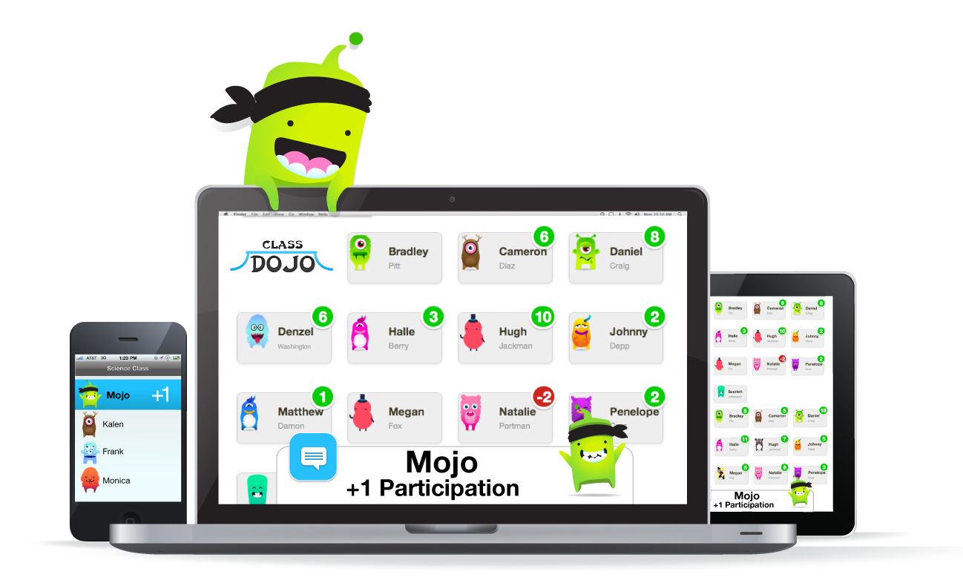
Homework
Practice Sight words EVERY NIGHT!
PARENTS ARE ASKED TO ASSIST AND NOT COMPLETE HOMEWORK ASSIGNMENTS FOR THEIR CHILD!!!!!
Why should students do homework?
It allows them to reinforce, review, and /or practice skills they have learned in class. It shows parents the important skills learned in class and allows them to become partners in their child’s education.
Course Description
Course Goals
Kindergarten is a time that children begin the process of becoming lifelong learners. It is a year for learning, growing, making friends, and having lots of fun too! Our days are filled with stories, letters, phonics, numbers, addition, subtraction, shapes, writing, and many other activities and memories. What a pleasure it will be to have your child in my classroom!
I have an exciting year planned full of opportunities for learning and growing. Your child will be studying about many aspects of life including; self, home, family, and community throughout the year, in addition to the Common Core Standards.
Georgia’s standards and expectations for Kindergarten students are complex. We work on social skills, rules, character traits and counting, all while singing and becoming independent learners. I know you will be fascinated when he/she learns how to write he/she’s first and last name, learn colors, upper and lowercase letters, letter sounds, vowels and their sounds, cvc words, sight words, rhyming, segmenting, identifying shapes and number 1-20, write numbers 1-20, count to 100 by 1s and 10s, adding and subtracting and much more. Don’t worry…I will be discussing all of these things with you many times throughout the school year. Again, please message or call me if you have questions, comments, or concerns.
Classroom Management
This year, I will be using a program called Class Dojo to manage behavior in conjunction with the Ron Clark house system. Each child will have a “monster”/house that tracks their behavior using points.
Want your child to play some educational games online?
www.starfall.com
www.abcya.com

Slide 3
Course Assessment Plan
Progression toward grade level standards mastery will be assessed with student checklist, Gkids, iReady growth checks, and observations. “Tickets out the door” will be used DAILY. The students will take a pre/post test for each unit that is taught in conjunction with weekly common assessments. The students will complete iReady diagnostic assessments 3 times throughout the school year.
Drop off/Pick-up
Standards Mastery
Mastery is determined using a standards-based rubric which determines the grades that students receive on their progress report and report card. The report card for grades K-3 will include a grading scale (1-4).
1- Beginning Learner
2-Developing Learner
3-Proficient Learner
4-Distinguished Learner
School starts at 7:25 a.m. and ends at 2:10 p.m. Please have your child dropped off and picked up on time everyday. If you would like for your child to eat breakfast, please drop him/her off before 7:25 to ensure that he/she does not miss valuable instruction time. The cafeteria opens at 7:00 a.m. I need to be informed of any changes to the way your child will get home DAILY. If your child’s regular transportation method is going to change for any reason I must have that in writing. Legally, I cannot take your child’s word for it or allow a child to leave school through a verbal agreement with you. IT MUST BE PUT IN WRITING.
Attendance
Students are expected to come to school EVERYDAY! We want all of our students at LME to be academically successful. Students will have to be present to learn the skills that they need to master the standards being taught.
Class Expectations
Rule #1: We Raise our Hand to speak.
Rule #2: We follow directions quickly!
Rule #3: We are kind. We are Honest.
Rule #4: We listen when our teacher is talking.
Rule #5: We keep our hands and feet to ourselves.
.
EXTRA HELP
Daily interventions will be done with students that need extra academic support.

